Slide 1

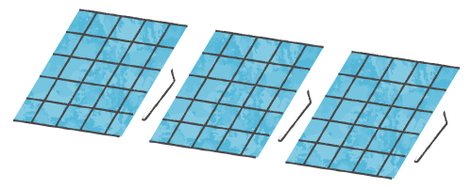
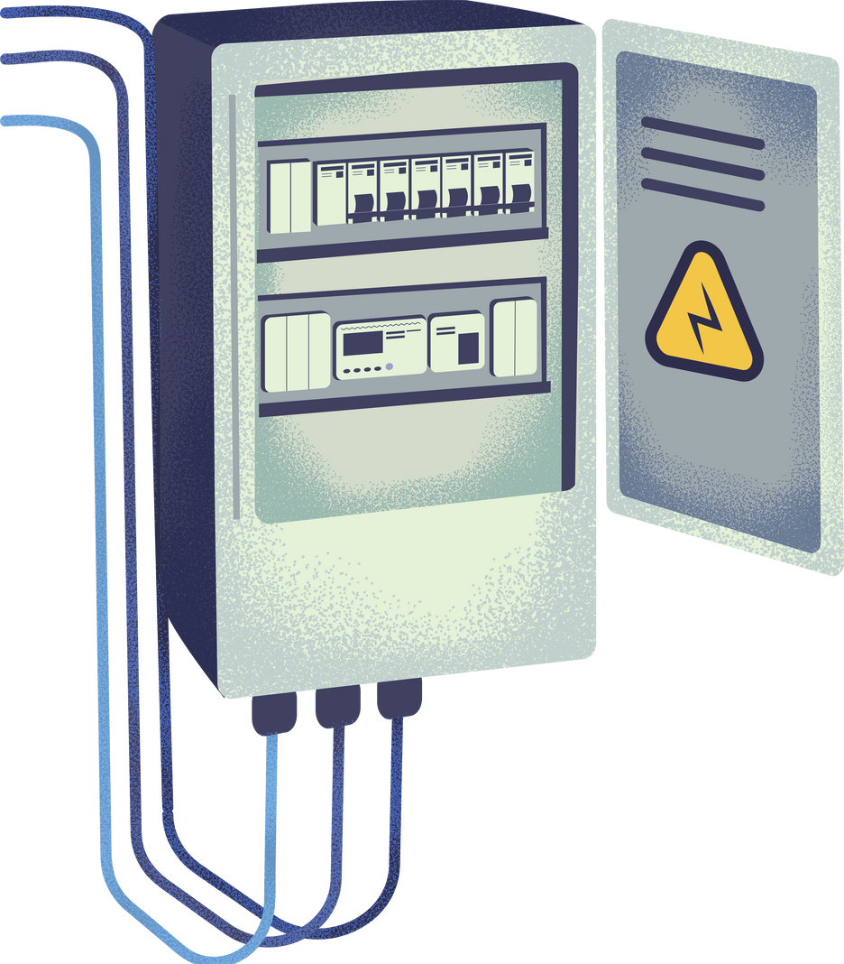



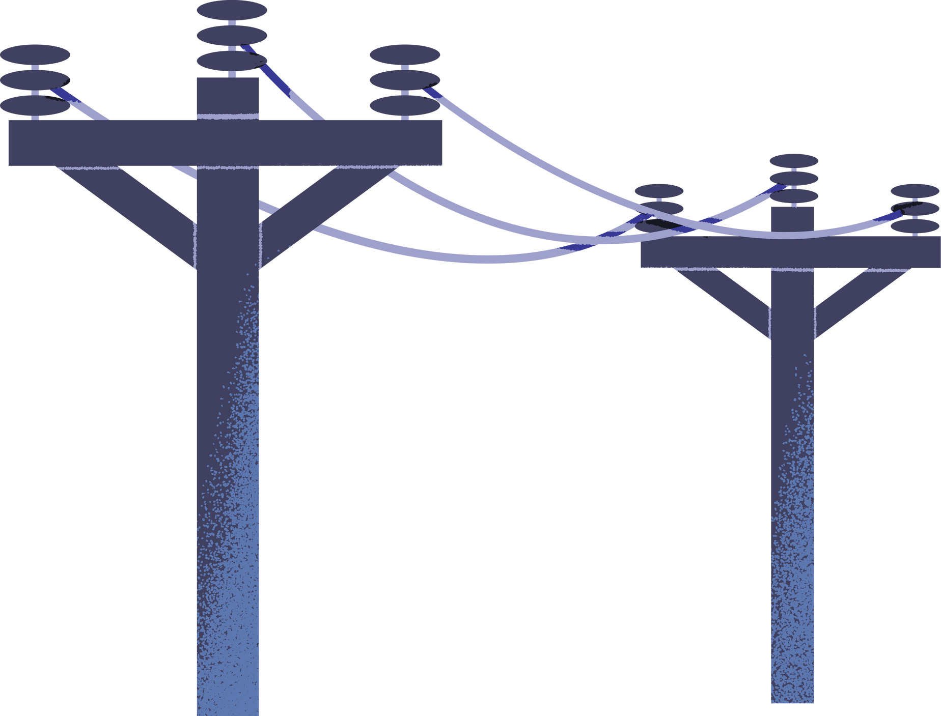
Impact of social comparison nudges on peak Electricity Use in Kenya
Difference-in Difference Panel analayis Experimental study (1000 households, 6 months)

Slide 2
Content
1.Introduction
2.Objectives
3.Hypothesis
4.Methodology
5.Analysis and Insights
6. Recommendations

Slide 3
Introduction
Kenya faces significant electricity demand during peak hours(6pm- 11pm)
Peak demand increases grid stress and generation costs
Demend-side solutions are critical for sustsinable energy management
Problem Context
Peak-hour electricity requires expensive backup generation
Infrastructure expansion is capital-intensive
Small behavioral shifts at household level may reduce system strain

Slide 4
Objectives
Evaluate the impact of social comparison messaging on peak electricity usage
Measure changes in Peak Energy Waste Index(PEWI)
Estimate casual effect using Difference-in-Differences
Quantify economic and system-level implications

Slide 5
Hypothesis
Null Hypothesis (H₀):
There is no difference in peak electricity usage between control and treatment groups
Alternative Hypothesis(H₁):
Households receiving social comparison + cost message reduce PEWI more than control households
Expected Direction
Negative treatment effect (β < 0)

Slide 6
Methodology
Experimental Design
1000 households(500 control, 500 treatment)
6-month panel dataset
Months 1-2; Baseline period
Months 3-6: Intervention period
Treatment: Social comparison + cost-equivalent messaging
Outcome Measurement
Peak Energy Waste Index (PEWI)
PEWI= Peak Kwh/Total Monthly kwh
Measures household contribution to peak demand
Lower PEWI = Reduced grid stress

Slide 7
Methodology
Estimation Strategy(Casual Identification Strategy)
Validated parallel trends (pre-treatment test)
Difference-in-Difference estimation
Two-Way Fixed Effects: Household fixed effects & Month fixed effects
Robust standard errors

Slide 8
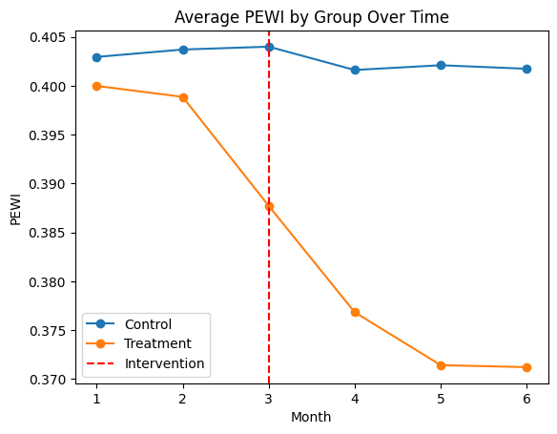
Analysis & Insights
Behavioral Impact
Line Chart showing:
Control PEWI trend
Treatment PEWI trend
Vertical line at Month 3 (Intervention)
Parallel trends observed pre-intervention
Clear divergence after Month 3
Treatment group shows sustained decline

Slide 9
Analysis & Insights
Difference-in-Difference Results
==================================================================================
coef std err z P>|z| [0.025 0.975]
----------------------------------------------------------------------------------
Intercept 0.4033 0.002 201.435 0.000 0.399 0.407
treatment -0.0039 0.003 -1.383 0.167 -0.009 0.002
post -0.0010 0.002 -0.388 0.698 -0.006 0.004
treatment:post -0.0217 0.003 -6.263 0.000 -0.028 -0.015
Key Result:
Treatment * post = -0.0217
p-value < 0.001
95% Cl: [-0.025,-0.018]
Interpretation
2.17 percentage point reduction in PEWI
≈ 5.4% relative decline in peak usage

Slide 10
Analysis & Insights
Economic Implications
Per Household:
≈ 3.25 kWh saved per month
500 Treated Households:
≈ 1,625 kWh saved monthly
Scaled to 100,000 Households:
≈ 0.325 GWh reduction per month
Estimated Cost Savings (KSh 25/kWh):
≈ KSh 81 per household per month
≈ KSh 40,625 system savings monthly (500 HH)

Slide 11
Recommendations
Policy Recommendations
Deploy social comparison + cost messaging at national scale
Integrate peak-hour reminders into existing SMS billing systems
Prioritize high peak-usage households for targeted nudges
Monitor impact through monthly PEWI tracking

Slide 12
Recommendations
Strategic Implications for Energy Management
Behavioral nudges are a low-cost alternative to infrastructure expansion
Supports demand-side management strategy
Reduces peak stress without capital-intensive investment
Scalable and adaptable across regions

Slide 13
Thank You

